Slide 1
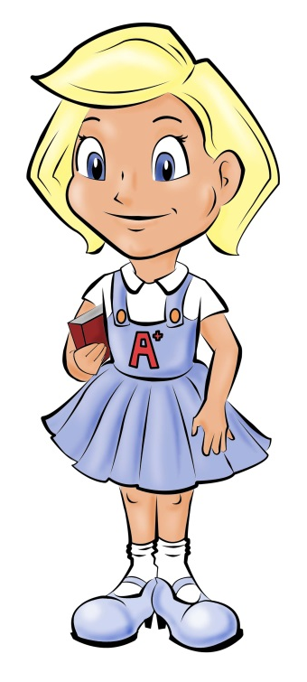
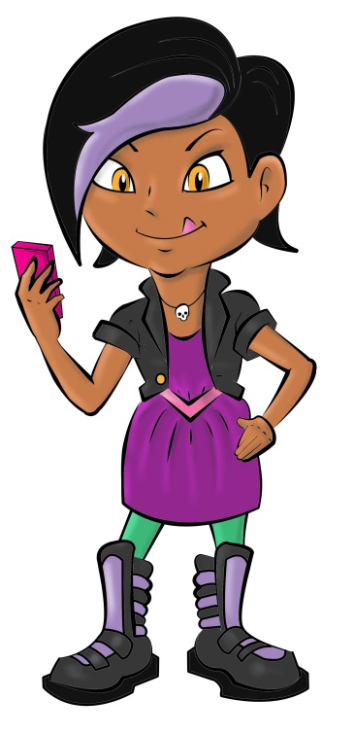
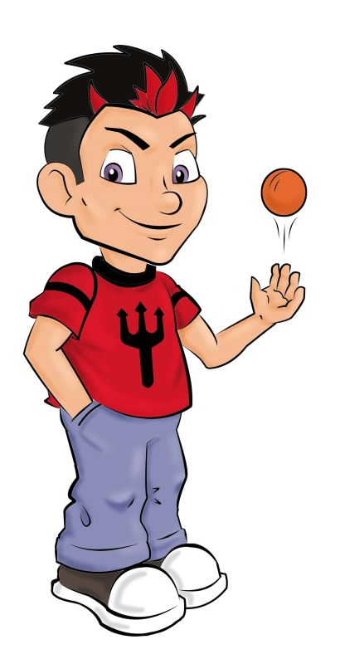
Spelling
Good
Naughty
Gail Gary
Nina Neil
Add ‘good’ spelling rules / patterns / graphemes here as you cover them in class
Add ‘naughty’ words here as you cover them in class
© www.SaveTeachersSundays.com 2013

Slide 2
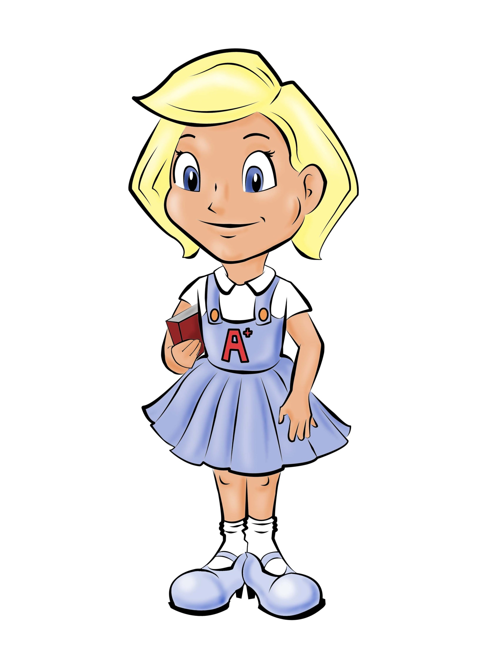
© www.SaveTeachersSundays.com 2013

Slide 3
© www.SaveTeachersSundays.com 2013

Slide 4
© www.SaveTeachersSundays.com 2013

Slide 5
© www.SaveTeachersSundays.com 2013

